Slide 1
Numerical and Scientific Computing in Python

Slide 2
Python and Scientific Computing
Python was originally developed as a general purpose programming language. The basic language:
Cannot handle matrixes (lists / arrays are not the same thing)
Is missing a lot of math functionality (e.g., Fourier analysis, polynomials, statistical methods, etc.)
Has no graphical plotting functions
Cannot read medical images (DICOM)
But, all of the above (and much more) are freely available from 3rd party Python (scientific) libraries

Slide 3
NumPy
Numerical Python. Adds the basic functionality for numerical computing:
Matrices and linear algebra
Fourier analysis and polynomials, etc.
It is used by many other scientific computing libraries
New data type: NumPy array
NumPy arrays feel a bit like Python lists, but:
Act as n-dimensional matrixes (including all matrix operations, i.e., linear algebra)
Have restrictions: e.g., cannot mix-up strings and numbers in the same array

Slide 4
Error: can’t do math operations on a list
v = [0.5, 3]
print(v + 5)
Commonly done to reduce typing
import numpy as np
v = np.array([0.5, 3])
print(v + 5)
Create a numpy array
Create a 2D matrix
M1 = np.array([[1, 5], [3, 7]])
M2 = np.array([[2, 6], [0, 4]])
print(M1)
print(M2)
print(M1 - M2)
print(M1 * M2)
By default, all math operations are element-wise

Slide 5
M1 = np.array([[1, 0], [0, 1]])
M2 = np.array([[1, 3], [5, 7]])
print(M1 * M2)
print(M1 @ M2)
@ for matrix multiplication
print(np.arange(3, 16, 2))
v1 = np.linspace(3, 16, 5)
print(v1)
print(np.round(v1, 1))
NumPy has many, many useful functions
Try some out: np.
sin, cos, pi, floor, ceil, sum, min, max, mean, exp, log, pow, mod, sqrt, sign, …
All of them work on both scalars and arrays

Slide 6
Misc. convenient functions
print(np.eye(3))
print(np.zeros([2, 5]))
print(np.full(8, fill_value=-3))
Function arguments in python can also be specified using keywords
Create deterministic random numbers
rng = np.random.default_rng(42)
print(rng.integers(1, 7, size=[4, 4]))
The random seed sets all the subsequent random numbers
rng = np.random.default_rng(123)
M3 = rng.integers(0, 100, size=10)
print(M3)
print(M3 > 50)
print((M3 != 5) & (M3 <= 50))
Logical operations

Slide 7
rng = np.random.default_rng(0)
M4 = rng.uniform(0, 1, size=[2, 5])
M4 = np.round(M4, 2)
print(M4)
print(M4[0, [0, 1, -1]])
print(M4[:, 3])
Integer array indexing
In Python, indexes start with zero
Make a copy of the array
M5 = M4.copy()
M5[0, 1:3] = 0
print(M5)
M5[M5 < 0.6] = 0
print(M5)
Integer and Boolean Array indexing can also be used for assignment
M5 = M4.copy()
tmp = np.array([[1,1,1,0,0], [0,1,0,1,1]]).astype(bool)
print(tmp)
M5[tmp] = -1
print(M5)
Convert to booleans

Slide 8
rng = np.random.default_rng(321)
M6 = rng.integers(0, 10, size=[3, 1])
M7 = rng.integers(0, 10, size=[3, 5])
print(f"shape: {M6.shape}")
print(M6)
print(f"shape: {M7.shape}")
print(M7)
print(M6 + M7)
NumPy broadcasting automatically extends math operations across dimensions where possible

Slide 9
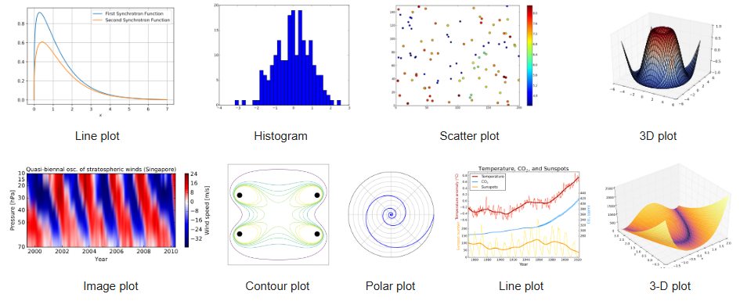
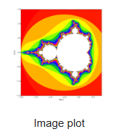
Matplotlib
The most popular Python library for plotting
Originally designed to imitate MATLAB’s plotting functions
MATlab-PLOT-LIBrary
Behaviour of plots differs when run in command prompt interpreter vs. IDE vs. Jupyter notebook
plots in IDE and Jupyter are static by default; command prompts ones are interactive

Slide 10
import numpy as np
import matplotlib.pyplot as plt
x = np.linspace(0, 2*np.pi, 100)
plt.plot(x, np.sin(x))
Import the plotting module
Plot a sine wave
fig, ax = plt.subplots()
x = np.linspace(0, 1, 100)
colors = ["r", "g", "b"]
for n in range(3):
c = colors[n]
ax.plot(x, np.sin(x*2*np.pi*(n+1)), color=c)
Multiple plots, customizing colours
rng = np.random.default_rng(0)
x = rng.normal(loc=0, scale=1, size=10000)
y = rng.uniform(0, 1, size=10000)
plt.plot(x, y, '.k', markersize=1)
Scatterplots

Slide 11
rng = np.random.default_rng(99)
d1 = rng.normal(loc=0, scale=1, size=10000)
d2 = rng.uniform(0, 1, size=10000)
_, (ax1, ax2) = plt.subplots(nrows=2)
_ = ax1.hist(d1, bins=100)
_ = ax2.hist(d2, bins=100)
Histograms
_ on the left means to ignore the returned value
rng = np.random.default_rng(50)
x = rng.normal(loc=50, scale=10, size=1000)
x = np.log(x) # make it skewed
_, (ax1, ax2) = plt.subplots(nrows=2)
ax1.boxplot(x, vert=False)
_ = ax2.hist(x, bins=100)
ax1.set_axis_off()
ax2.get_yaxis().set_visible(False)
ax2.spines["top"].set_visible(False)
ax2.spines["left"].set_visible(False)
ax2.spines["right"].set_visible(False)
Boxplots
Customizations!

Slide 12
xy = np.linspace(-10,10,100)
xx, yy = np.meshgrid(xy, xy)
rr = np.sqrt(xx**2 + yy**2)
print(rr.shape)
_, (ax1, ax2) = plt.subplots(ncols=2)
ax1.imshow(rr)
ax2.imshow(rr <= 5, cmap="gray")
A (grayscale) image is just a 2D matrix
rng = np.random.default_rng(99)
img = rng.integers(0, 8, size=[5, 5, 3])
plt.imshow(img*32) # scale to ≈8-bit
for n in range(3):
print(img[:,:,n])
A colour (RGB) image is just a “3D” matrix
img[0, 0] = [7, 7, 0] # make the top-left yellow
img[-1, -1] = [7, 3, 0] # make the bot-right orange
plt.imshow(img*32)

Slide 13
NumPy and Matplotlib are enough to do a lot of scientific computing already.

